Slide 1

How do we make money in the stock market?

Slide 2

The Question
How do we make money?
How do we make money in the stock market?
What financial factors affect market value?
Is sales growth a good predictor for market value appreciation?

Slide 3

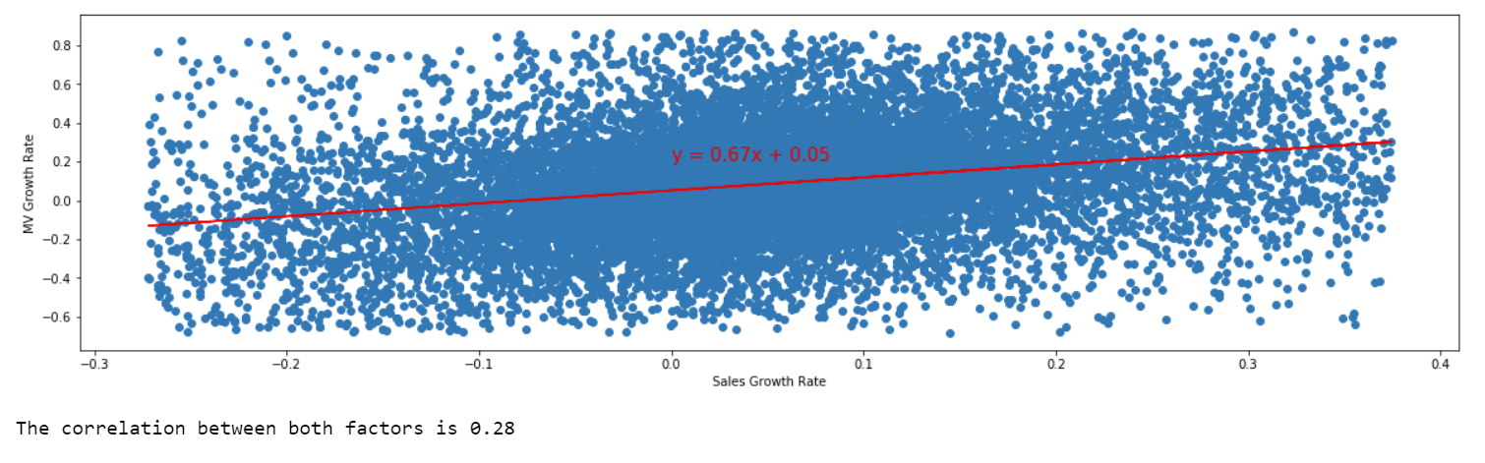
Our Findings
Figure 1 – Quarterly Sales Growth (%) vs. Quarterly Market Value Growth (%)

Slide 4

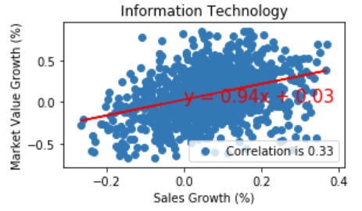
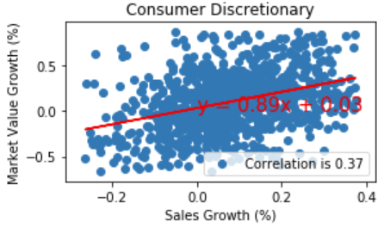
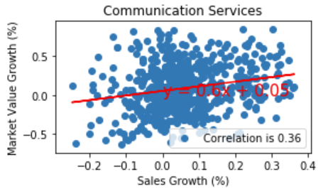
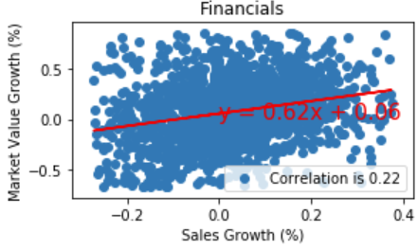
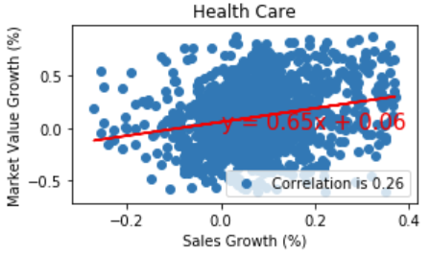
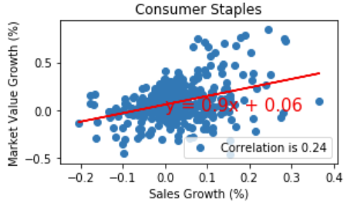
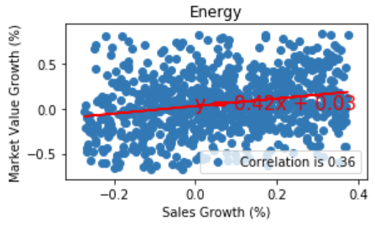
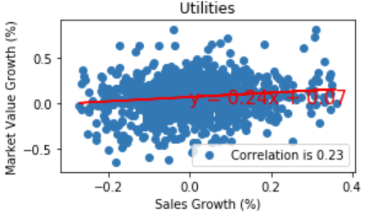
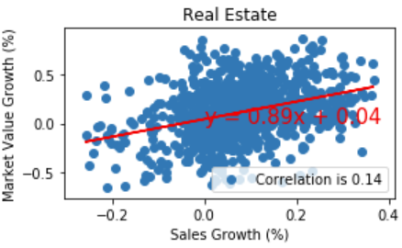
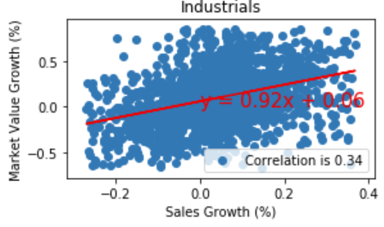
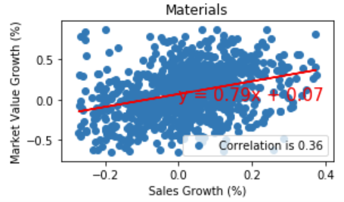
Our Findings (Sector Specific)
Figure 2 – Quarterly Sales Growth %) vs. Quarterly Market Value Growth (%) for each Market Sector

Slide 5

Incomplete Story
Effect of other untested factors
1. Mergers & Acquisitions
2. Political Events
3. Natural Disasters and Epidemics
Correlation vs causation
Practicality

Slide 6

Appendix

Slide 7
Data Collection and Processing
Data used for this analysis consisted:
A csv file of stock code, company name, quarterly sales, and quarterly market value from March 2007 to September 2018
A csv file of stock code, company name, and stock sector/industry
The two files were joined and rows with null or empty values for any of the financial data points were removed
Company sales growth (%) quarter-over-quarter, and year-over-year were calculated and added as columns to the source file
Company market value growth (%) quarter-over-quarter and year-over-year were calculated and added as columns to the source file
A scatter plot was created to show whether there is any correlation between the growth of company sales to their growth of market value. See Figure 1.

Slide 8
Analysis
We observed an overall correlation of 0.28, which shows a positive correlation between the two variables. Positive correlation indicates that sales growth is a good starting point to determine stock market value growth
Every company has a common goal of attempting to Sell a product/service with more volume and price
A company similar to an organism is quite complex and many other variables may impact the stock market value
The recent time period shows how the market value is changing very rapidly with market participants estimating what the future financial results will be

Slide 9
Analysis by Market Sector
For this analysis, the same two variables were calculated for each of the 11 market sectors (Global Industry Classification Standard) in the dataset
Scatterplots were created including the linear regression model. See Figure 2.

Slide 10
Market Sector - Key Findings
Energy (0.36) and Material (0.36) Sector correlation are higher as sales growth are driven by their respective commodity prices (Oil and Gold), which are traded daily in markets and which Financial Market Participants can value before financial results are reported.
The Real Estate Sector has the lowest correlation (0.14) as Real Estate is valued by market participants by NAV (Net Asset Value Per Share) due to share dilution
The Utilities Sector also has a lower correlation (0.23) as sales are fixed due to the regulated nature of the business sector.

Slide 11
Limitations & Biases
Stock markets opening in various time zones causes results from end of day in one market to influence decisions made in another market
Fiscal year-end is not consistent across all organizations, and Financial reports are not all released at the same approximate time
We only took stocks traded by one financial institution, so our sample data was slightly biased towards what that particular company trades
We removed companies with incomplete data (not all quarters were available)
We removed companies which reported their Financial in a different month than the Fiscal quarter

